Slide 1



12.B VALIDATING NETWORK CONFIGURATION
test and inspect current network configuration
with command-line utilities.

Slide 2

GATHERING NETWORK INTERFACE INFORMATION

Slide 3


Identifying Network Interfaces
[user@host ~]$ ip link show

Slide 4
Displaying IP Addresses
[user@host ~]$ ip addr show ens3

Slide 5
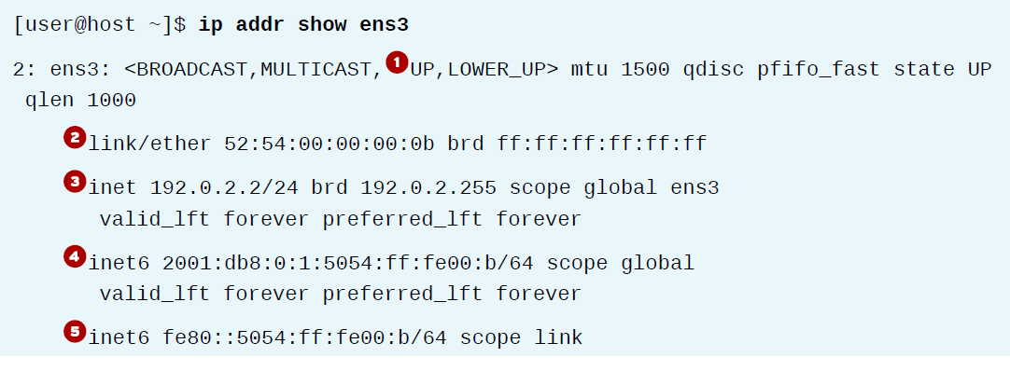

Slide 6
Displaying Performance Statistics
[user@host ~]$ ip -s link show ens3

Slide 7
CHECKING CONNECTIVITY BETWEEN HOSTS
[user@host ~]$ ping -c3 192.0.2.254
[user@host ~]$ ping6 2001:db8:0:1::1

Slide 8
Finding other nodes
[user@host ~]$ ping6 ff02::1%ens4

Slide 9
TROUBLESHOOTING ROUTING
Displaying the Routing Table
[user@host ~]$ ip route
[user@host ~]$ ip -6 route

Slide 10
Tracing Routes Taken by Traffic
Displaying the Routing Table
[user@host ~]$ tracepath access.redhat.com
[user@host ~]$ tracepath6 2001:db8:0:2::451

Slide 11
Tracing Routes Taken by Traffic
Displaying the Routing Table
The traceroute command has options to trace the
path with UDP (default), ICMP (-I), or TCP (-T) packets.

Slide 12
TROUBLESHOOTING PORTS & SERVICES
ss replace the older tool netstat
[user@host ~]$ ss -ta

